Slide 1
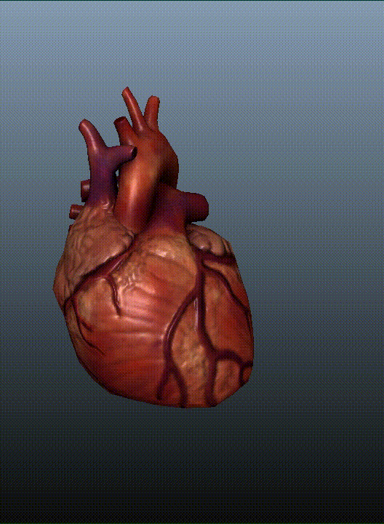
The Circulatory System
AEHBY ATAR Human Biology

Slide 2
Review
Summarise the three stages of cellular respiration, including location, inputs, outputs and ATP production.
Identify and briefly describe two other types of respiration.
List three factors that contribute to the efficiency of alveolar gas exchange.
Sketch four graphs which represent factors affecting enzyme activity.

Slide 3
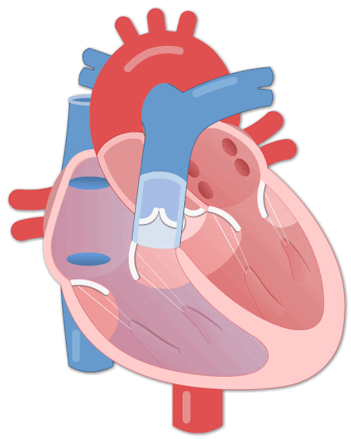
Learning Intentions
The transport of materials within the internal environment for exchange with cells is facilitated by the structure and function of the circulatory system at the cell, tissue and organ levels

Slide 4
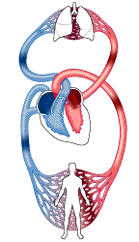
Success Criteria
Label the chambers, blood vessels and valves of the heart
Describe the arteries, capillaries and veins in terms of structure (tissues and organs) and function.
Describe the cardiac cycle and cardiac output

Slide 5
The heart
A muscular four chambered organ divided into two sides by a thick wall or septum.

Slide 6
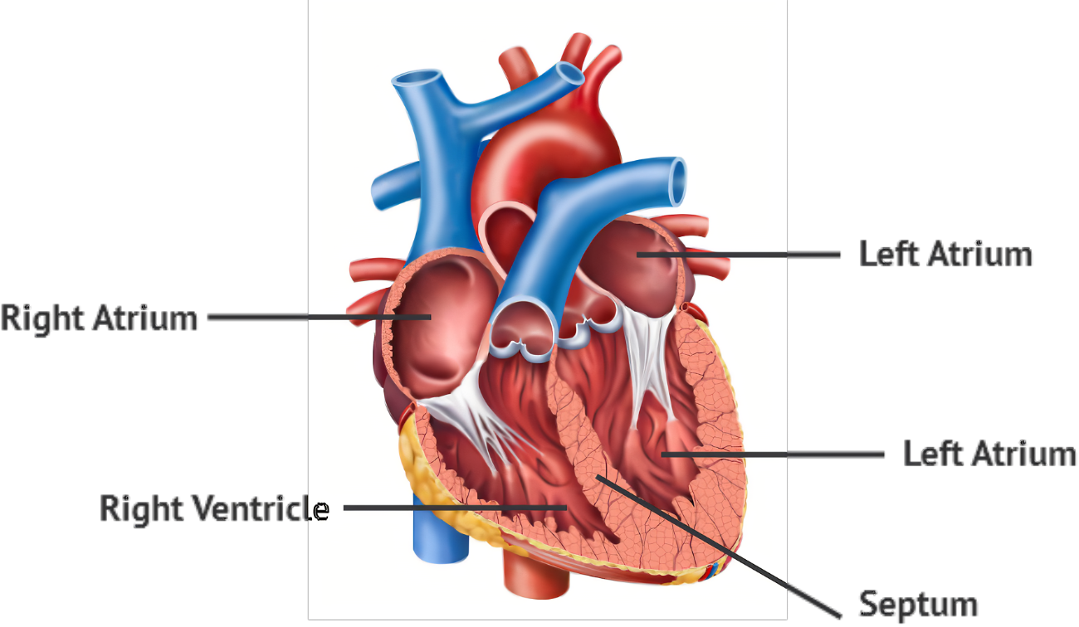

Slide 7
The heart
A muscular four chambered organ divided into two sides by a thick wall or septum.
The right side receives deoxygenation blood from the body and sends it to the lungs for oxygenation (thinner walled).
The left side receives oxygenated blood from the lungs and sends it the body for internal respiration (thicker walled).

Slide 9
The heart
A muscular four chambered organ divided into two sides by a thick wall or septum.
The right side receives deoxygenation blood from the body and sends it to the lungs for oxygenation (thinner walled).
The left side receives oxygenated blood from the lungs and sends it the body for internal respiration (thicker walled).
Atria (thin walled) are separated from the ventricles (thick walled) by valves which prevent blood from flowing backwards during.

Slide 11
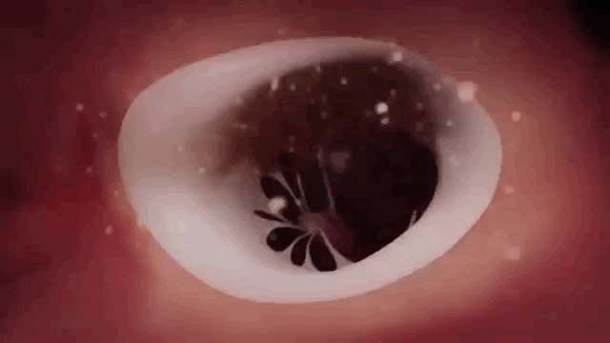

Slide 12
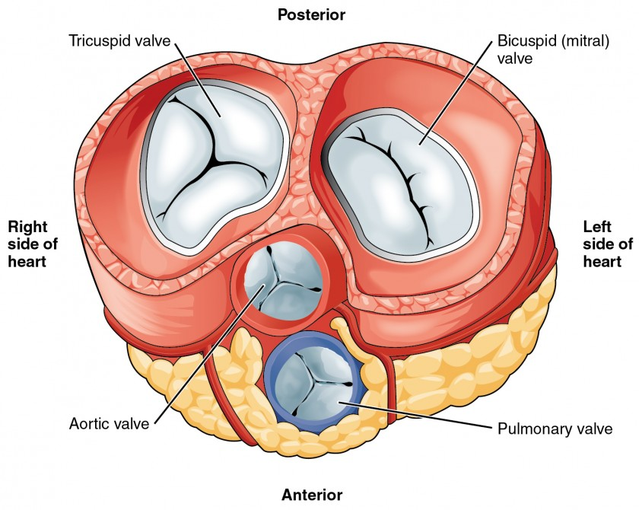
Valves
Atrioventricular (between atria and ventricles):
Tricuspid (Right)
Mitral/Bicuspid (Left)
Semilunar (between ventricles and arteries):
Pulmonary (right)
Aortic (left)

Slide 13
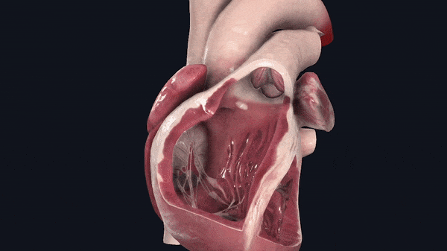

Slide 14
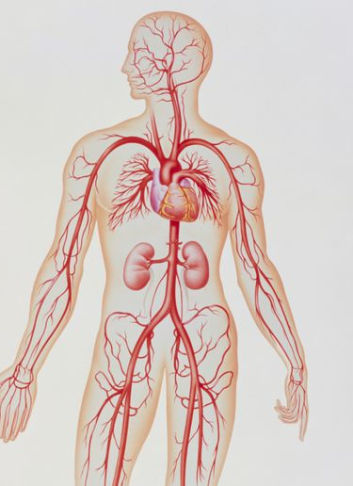
Blood vessels
Arteries
take blood away from the heart
thick walls contain smooth muscle and elastic fibres
stretch and recoil with each heart beat
muscle can contract or relax to restrict/redirect blood flow (vasoconstriction/vasodilation)

Slide 15
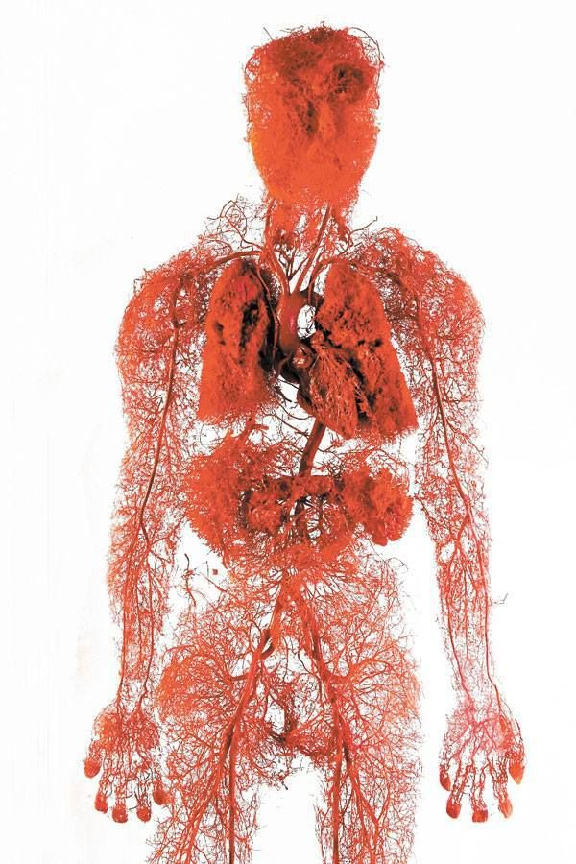
Blood vessels
Capillaries
allow substances to pass between blood and tissues
walls are only one cell thick (epithelium)
large volume reduces pressure and speed of blood flow

Slide 16
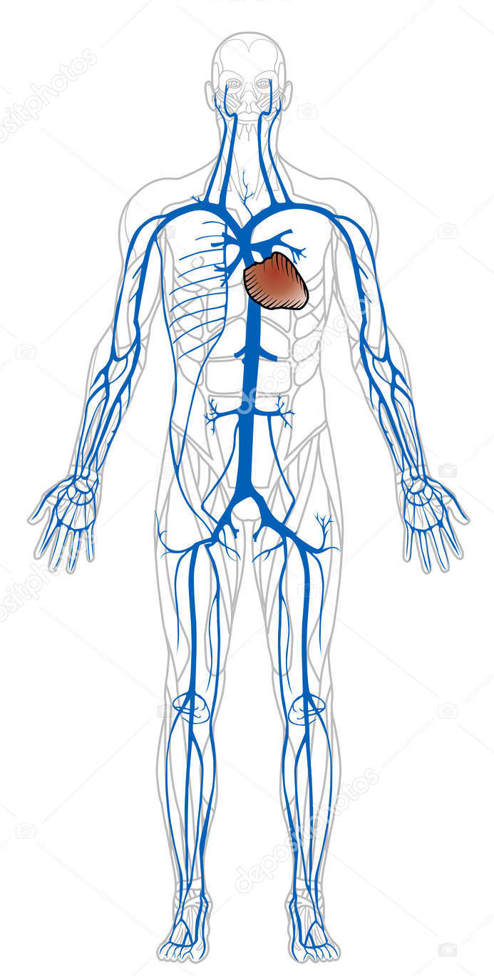
Blood vessels
Veins
return blood to the heart
thin, inelastic walls
constant low pressure
have valves to prevent backwards flow

Slide 17
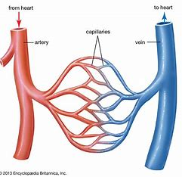
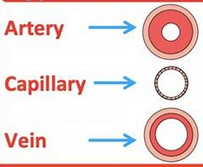
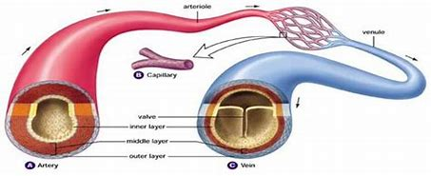

Slide 18
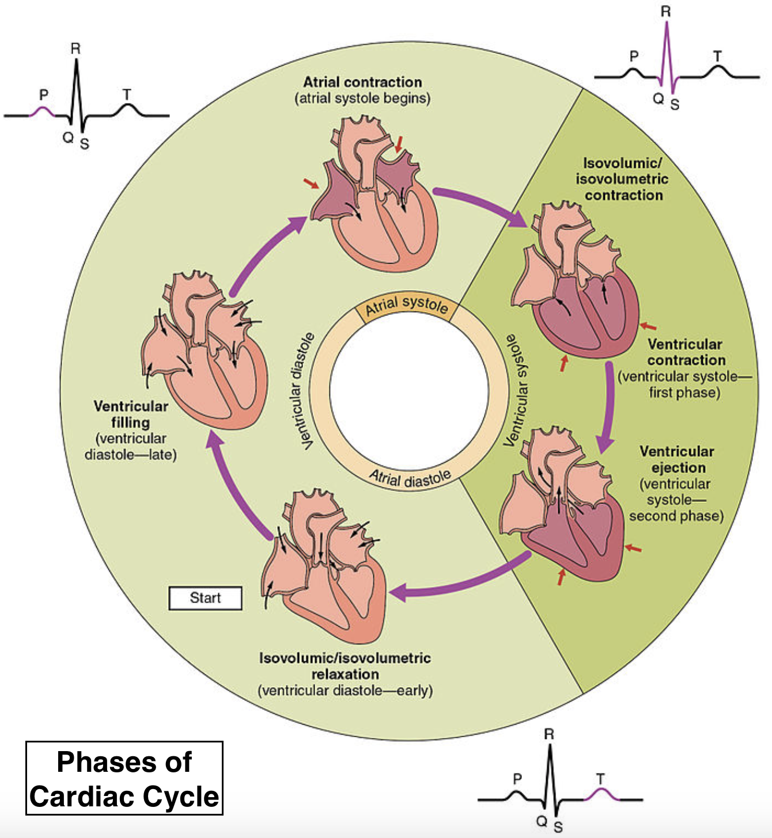

Slide 19
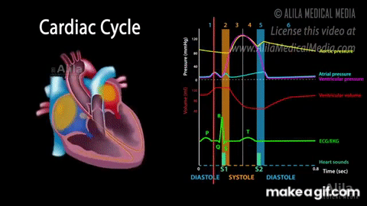
The cardiac cycle

Slide 20
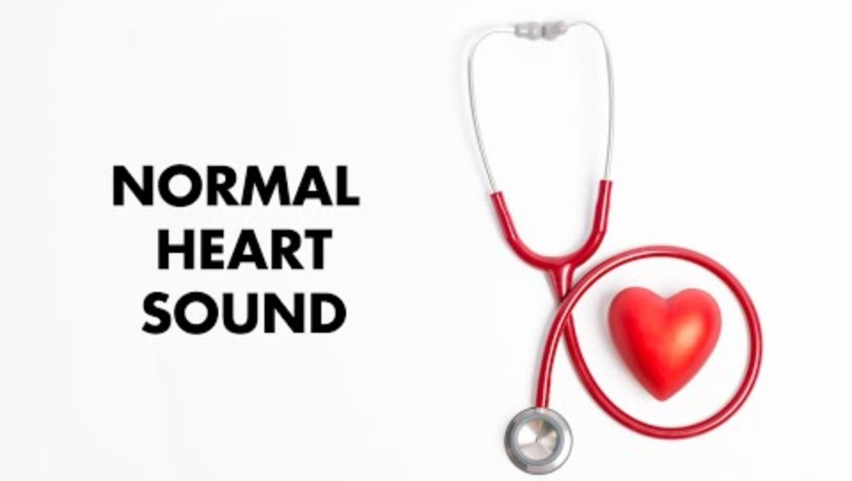

Slide 21
Cardiac output
Heart rate: contractions (beats) per minute
Stroke volume: volume leaving ventricles per contraction
Cardiac output (mL/min) = stroke volume (mL) x heart rate (bpm)

Slide 22
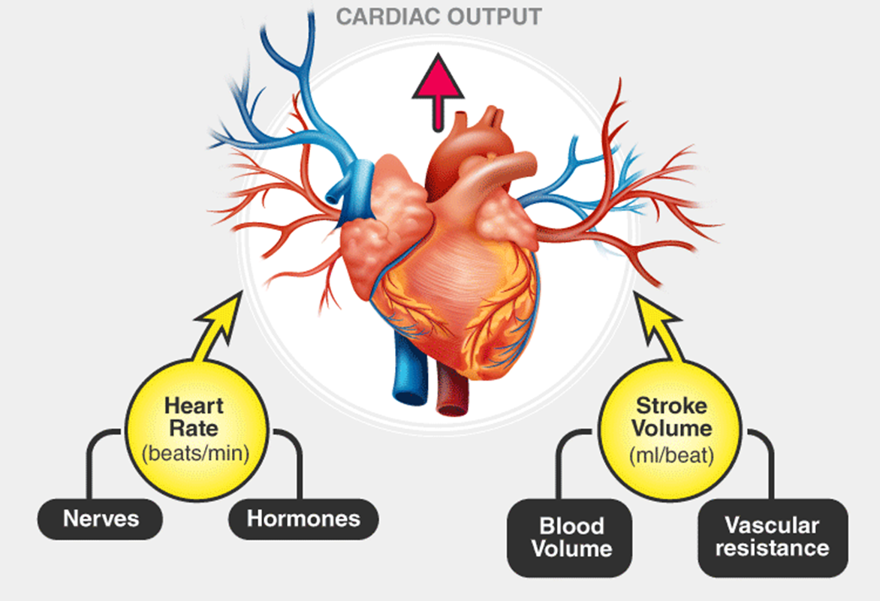

Slide 23
Success Criteria
Label the chambers, blood vessels and valves of the heart
Describe the arteries, capillaries and veins in terms of structure (tissues and organs) and function.
Describe the cardiac cycle and cardiac output

